Slide 1
Pivotal Cloud Foundry Security

Slide 2
Threat Types
Malware
Advanced persistent threats
Leaked credentials
The volume of threats is growing at an exponential rate. Attackers are moving faster and faster.
The types of threats you face are relatively simple.
Notes:
• Malware. This is a catch-all term for viruses, trojan horses, worms, spyware, and other programs that
have malicious intent.
• Advanced persistent threats. These are breaches where an attacker gains access to a network and
stays there undetected for a long period of time. The longer the threat stays undetected, the more
data that’s at risk.
• Leaked credentials. Credentials control access to information or other resources. No matter how
hard an organization tries to lock-down employee credentials to critical systems, they always seem
to get out into the wild.

Slide 3
Jobs to be Done
Reduce Risk in Your App Portfolio
Keep critical systems at 100% patch levels
Automate the path to production
Make the Secure Thing, the Easy Thing
“Secure by default”
Immutable infrastructure
Automate dependency management
Keep Up with Industry Regulations & Auditors
Embedded OS
Inherited controls
Use existing IdM policies
PRACTICES
PRACTICES
PRACTICES

Slide 4
PCF Security Concepts: Cloud Native Security
Immutable Infrastructure
2 layer Scheduler
Hardened Container Boundary
Constant, Full-stack patching
Ephemeral Servers
Fully Encrypted Network
Ubiquitous Policy Enforcement
Control of Software Supply Chain
Monitoring & Scanning Integration
Notes:
Immutable infrastructure - immutable infrastructure means that it never changes, it just gets re-created over and over. This is what we do with BOSH : https://blog.pivotal.io/pivotal-cloud-foundry/products/immutable-infrastructure-windows-and-bosh. If your infrastructure is changing often, advanced persistent threats are denied what they need to survive in your systems.
2-layer scheduler - this is encourages teams to go faster. We schedule the infrastructure with BOSH, and apps with Diego. This helps you update each without impact. Move fast without downtime!
Hardened container boundary - this means that containers, if a bad actor gets a hold of it, can’t break out and control the host or other parts of the system. We have AppArmor, seccomp, Garden runC to help in this area. These are all industry-standard security features that have been proven out by the Linux & container communities. These are embedded at the core of Pivotal Cloud Foundry: https://blog.pivotal.io/pivotal-cloud-foundry/products/adopting-the-runc-container-standard-in-cloud-foundry.
Constant, full-stack patching - don’t patch individual servers, pave them all at once with automation from BOSH. Take the latest “golden” image with the latest patches, make this a stemcell, and then do a rolling deployment (without downtime!) to get the most secure bits live in your environment. This works for the application layer as well, so the full-stack idea comes into play.
Ephemeral servers - servers that appear quickly, and go away just as quickly. Part of what we do with BOSH. Related to immutable infrastructure.
Fully encrypted network - encrypt data at rest and in transit. You can enable this within PCF, using our IPSec Add-on, to encrypt data as it flows through PCF.
Ubiquitous policy enforcement - the roles and permissions model is embedded in Cloud Foundry. Everyone in your dev and ops teams can have the right level of access for their job, and only access the apps that make sense for them to access.
Control of software supply chain - what’s running on your platform? With Buildpacks in Cloud Foundry, it’s easy to see what’s deployed, and what might be vulnerable. Administrators can control what Buildpacks are approved for use, and outdated buildpacks can be removed from the deployment.
Monitoring and scanning integration - PCF includes tools to ingest logs, events, and metrics, as well as some bundled anti-virus capabilities on our stemcells, with ClamAV.

Slide 5

Patching & Upgrades

Slide 6
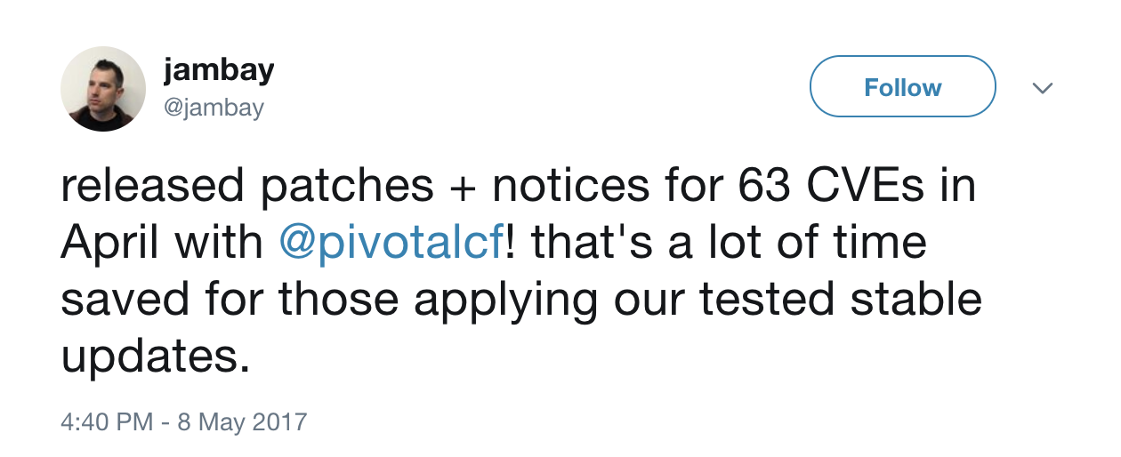
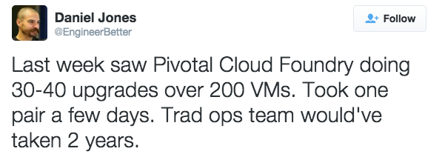

Slide 7
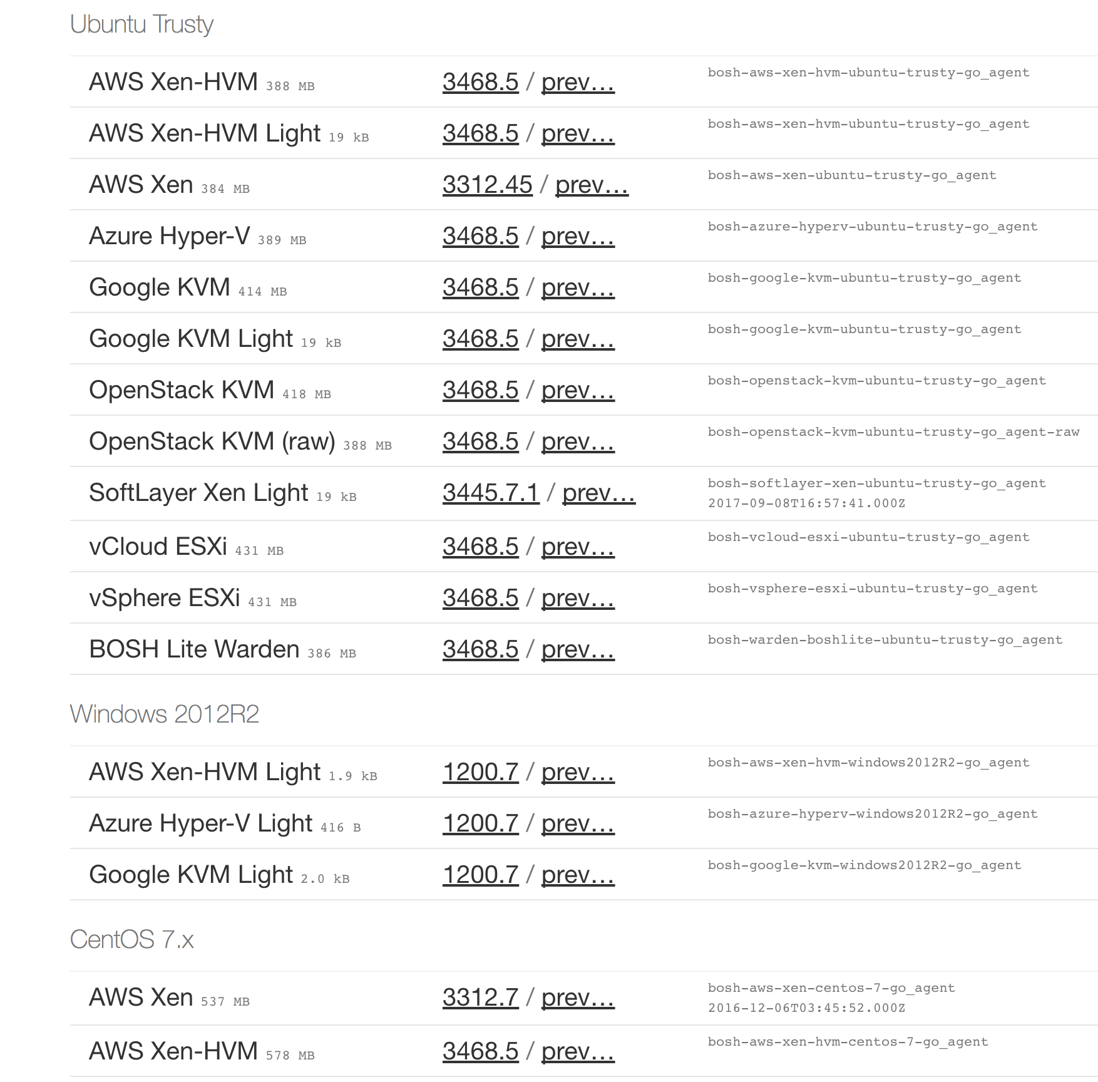
Stemcells
Secured, hardened, and versioned operating system image wrapped with IaaS specific packaging
Contains a bare minimum OS skeleton with a few common utilities pre-installed, a BOSH Agent, and a few configuration files to securely configure the OS by default
Stemcells are Windows or Linux based

Slide 8
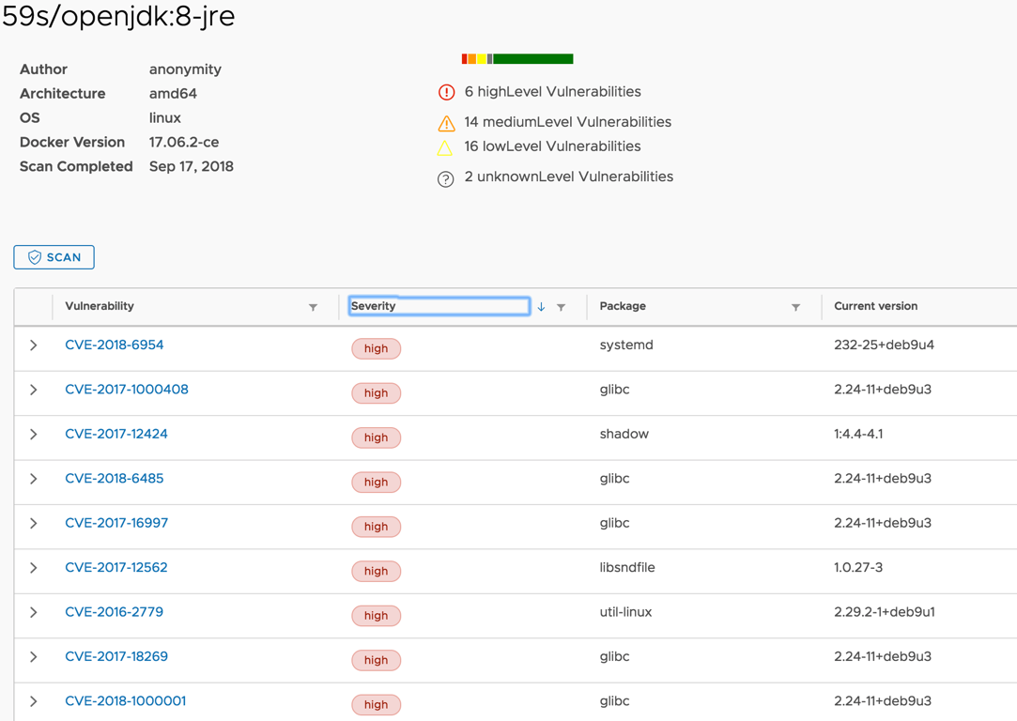
State of Container Images

Slide 9
Lifecycle Management
Pivotal
Customer
Updates Managed By
App (Your Biz Code)
App dependent Libs
App Runtime (.Net Framework)
RootFS (Container)
Container Orchestrator
Virtual Machine
Pivotal Cloud Foundry
BOSH + Buildpacks

Slide 10
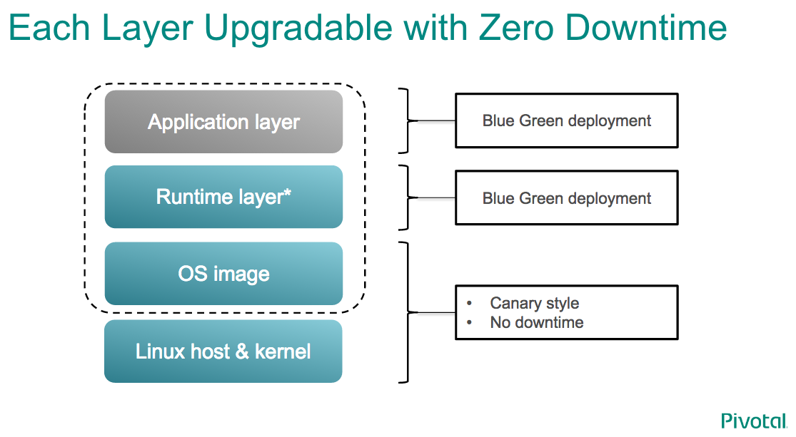
Security Process Strategy
Buildpack
App Bits + Middleware
rootfs
Filesystem
Stemcell
Kernel & Devices
container

Slide 11
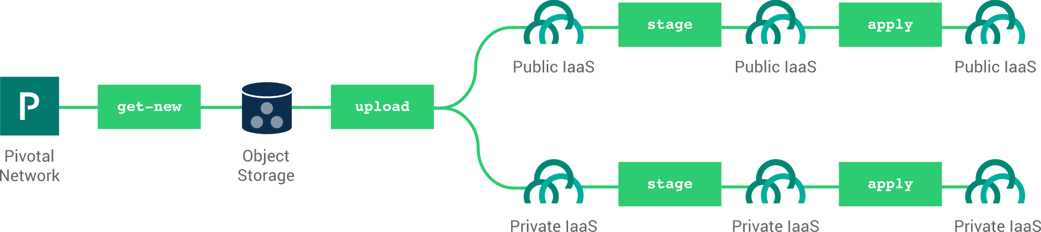
Zero Downtime Updates for OS, CVEs, Patches with CF BOSH
Notes:
1 command for zero downtime upgrade if the "Autopilot" or "BlueGreenDeploy" is used.

Slide 12
Credhub

Slide 13

CredHub Mitigates the Risk of Leaked Credentials
Credentials are the bedrock for trust in the cloud.
CredHub’s goal: deliver cradle-to-grave management of credentials (create, access control, distribution, rotation, logging)
Manages passwords, certificates, ssh keys, RSA keys, and arbitrary values (strings and JSON blobs).
All credentials are encrypted w/a key that rotates (HSM support in OSS & PCF)
CredHub delivers centralized management of platform and application creds. (Rotation in the future.)
Notes:
Secure credential management that runs on the BOSH VM.
Provides a CLI and API to get, set, generate, and securely store credentials.
CredHub is an OAuth2 resource server that integrates with User Account Authentication (UAA) to provide core authentication and federation capabilities.
Manages passwords, certificates, ssh keys, RSA keys, and arbitrary values (strings and JSON blobs).

Slide 14
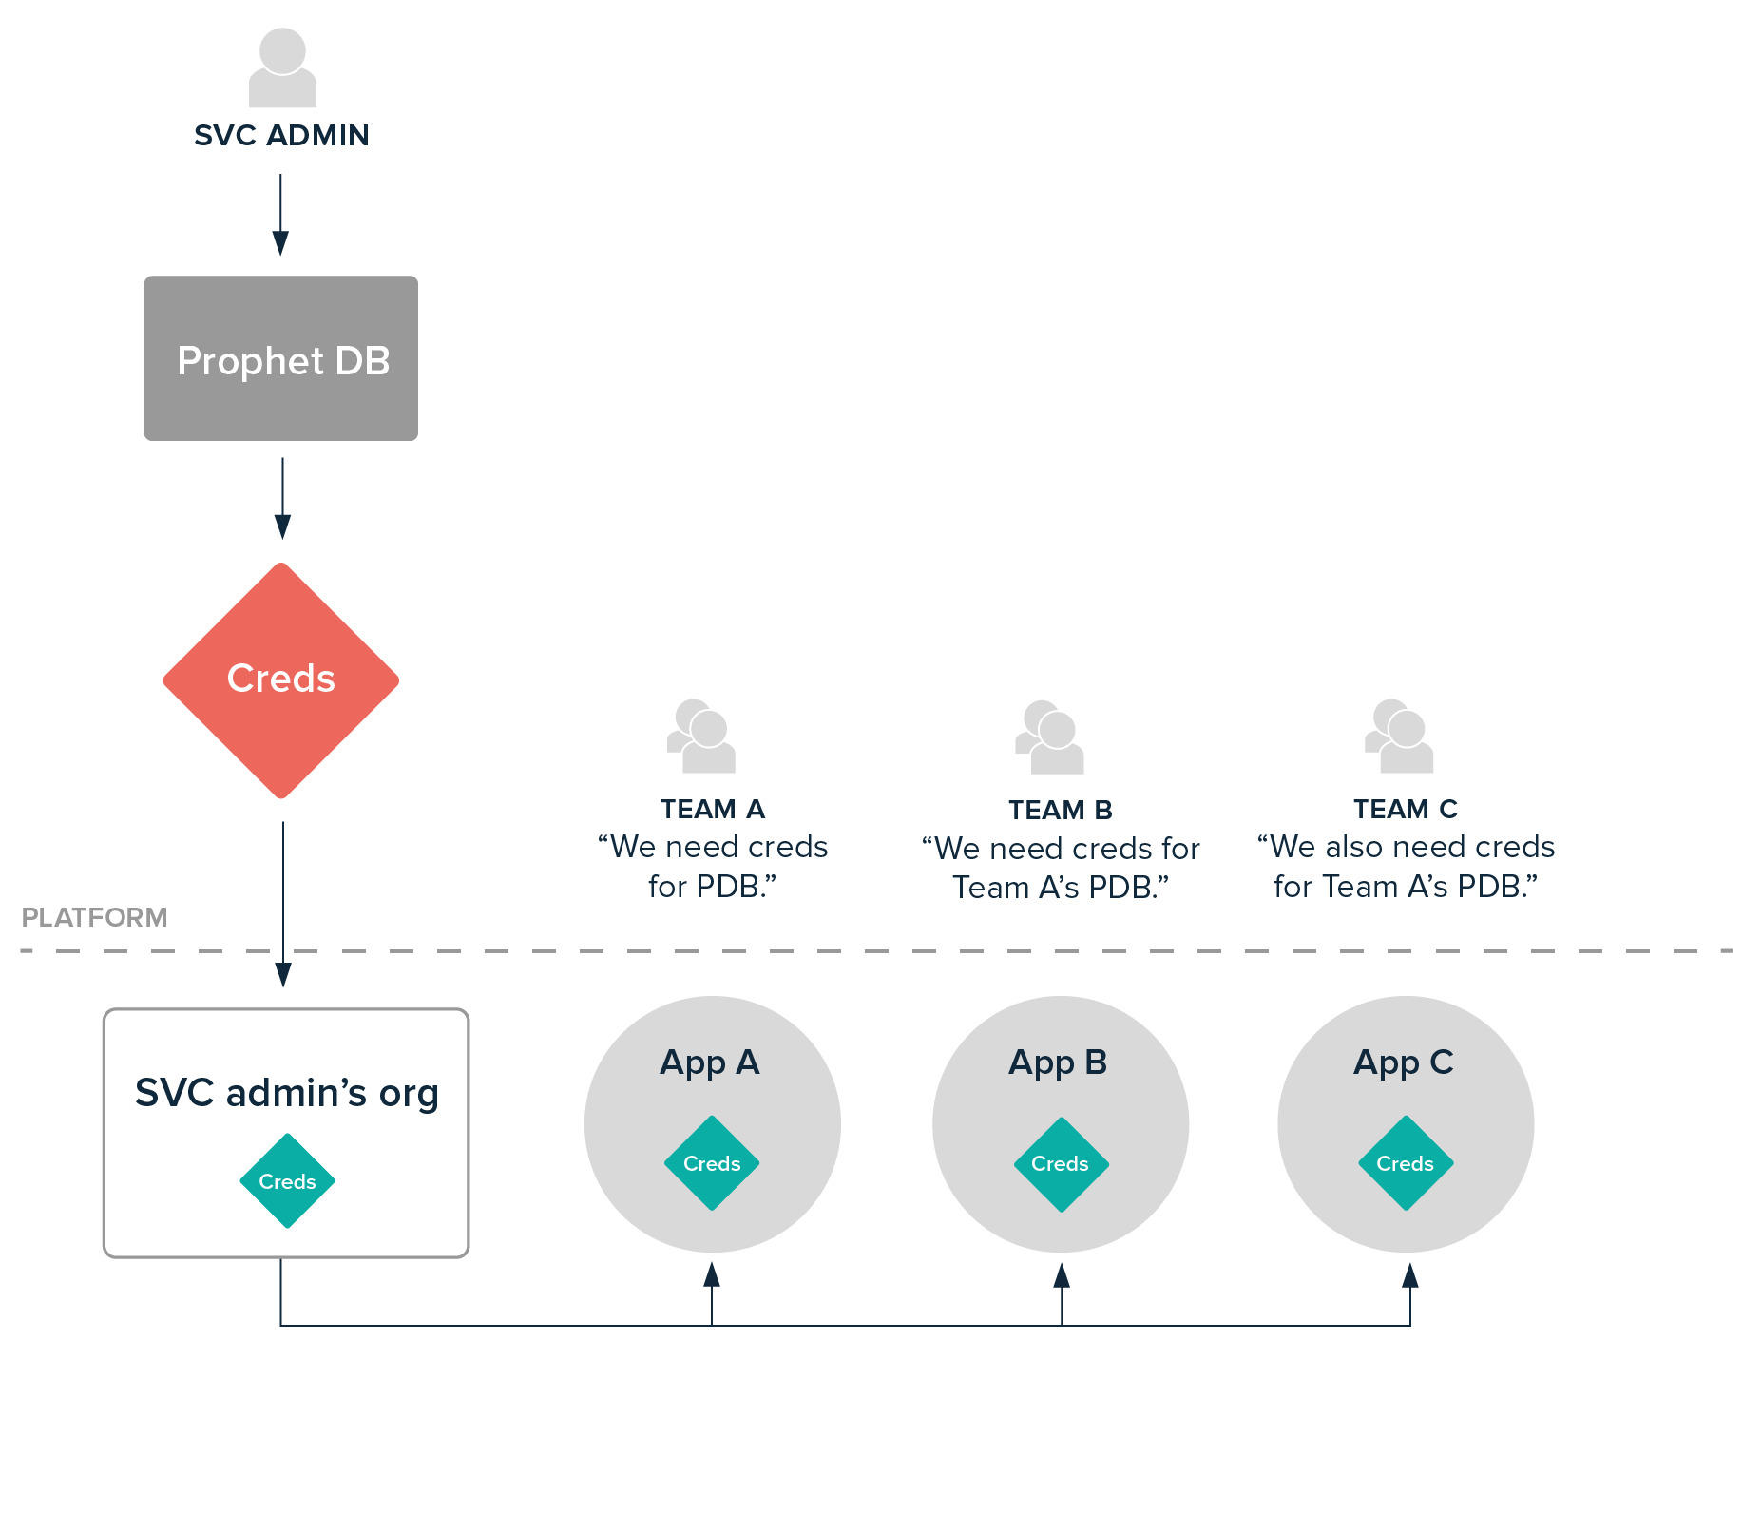
Secure Off-Platform Services with Service Instance Sharing & the CredHub Service Broker
cf create-service credhub default app-db -c '{"url":...,"username":...,"password":...}'
credentials: { credhub-ref: /c/prophet-db/app-db/credentials }
Notes:
Tutorial: https://content.pivotal.io/blog/protect-your-external-service-credentials-with-service-instance-sharing-and-the-credhub-service-broker-we-explain-how
Before:
A service administrator takes requests from app dev teams who want to interact with said service. (The "service administrator" in this case is whoever is responsible for providing service credentials for apps to use. This could be a DBA, a member of the InfoSec team, or a platform engineer or owner.) The admin does whatever provisioning they need to do—​create a new DB, generate a new user, etc. — and then they provide those credentials to a trusted member of the dev team. Sometimes a trusted third party, like the platform owner, gets the creds. The dev team (or the platform owner) provides those credentials to the application in any number of ways. The creds can go directly into app code or the app manifest. Some savvy teams may even create a custom user provided service (CUPS) in their org and space, and bind that service to the app. This may work well for your first or second app. But what about your twentieth? Your fiftieth? As the number of apps on your platform expands and intertwine, this flow can quickly grow unwieldy. For instance, consider the case where multiple teams need access to the same database or message queue. The service administrator now has to track which credentials are where, who would be affected by planned downtime—or even a security breach. And since that admin is handing out creds directly, there's a possibility that their reach has spread further than the admin themselves are even aware!
Now:
Here's how it works: when a dev team requests credentials to an external service - shown here as Prophet DB. The service admin provisions and generates credentials as usual. But instead of providing those values to app devs, they interface with the platform directly. In a Cloud Foundry® org and space (that only they control), the administrator creates a new instance of the CredHub Service Broker service. The newly-generated credentials are stored within that service. Then, using Service Instance Sharing, they share the new service to the org and space of the app devs. Now the app devs can bind their app to the service, and their apps on the platform can consume the credentials as usual. But if the devs try to inspect app metadata using Apps Manager or the "cf env" command, the value of the credential will be hidden from them, thanks to the CredHub Service Broker! If another team wants those credentials, the same exact admin-controlled service instance can be shared to their org and space as well, leaving in place an object trail of who is using which set of credentials. Pretty slick huh?

Slide 15

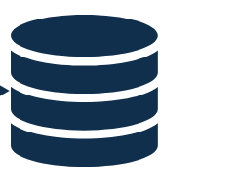

Architecture
BOSH
CLI
Authentication Provider
CredHub
Backing SQL Database
REST API
Encryption Provider (HSM)

Slide 16
Credential Interpolation
“VCAP_SERVICES”: {
“my-service”: [{
“credentials”: {
“credhub-ref”: “/c/my-broker/1111/2222/credentials”
},
}]
}
POST /interpolate
CredHub
“VCAP_SERVICES”: {
“service-name”: [{
“credentials”: {
“uri”: “https://service-6yQVNrhZVP.example.com”,
“username”: “VofTuQk2BH”,
“password”: “fRqah7Wygi”
},
}]
}
interpolated credentials

Slide 17
Assisted Credential Resolution
cf push
Cloud
Controller
V##P_#####
Diego
create env
Diego Cell
VCAP_SERVICES
App
POST /interpolate
VCAP_SERVICES
V##P_#####
CredHub

Slide 18


Non-Assisted Credential Resolution
cf push
Cloud
Controller
V##P_#####
Diego
create env
Diego Cell
VCAP_SERVICES
App
POST /interpolate
VCAP_SERVICES
V##P_#####
Spring applications using Spring Cloud Connectors or Spring Boot ${vcap.service.} properties will have framework support to automate resolution
CredHub

Slide 19

Application Benefits of Using CredHub
Assisted Mode
Non-Assisted Mode
Cloud Controller database (encrypted)
Cloud Controller REST API responses
/v2/apps/:guid/env
/v2/service_bindings/:guid
Staged application droplets
cf ssh
Cloud Controller database (encrypted)
Cloud Controller REST API responses
/v2/apps/:guid/env
/v2/service_bindings/:guid
Staged application droplets
cf ssh
Manual ssh
Process Environment
Application Memory

Slide 20
Identity & Access Control

Slide 21
Identity & Access Management
User Account and Authentication (UAA)
Role-Based Access Controls (User Roles)
Single Sign-On (SSO)
CredHub
REST API (cf curl)
Service Brokers
Notes:
explain what it is and outcome

Slide 22
User Account and Authentication (UAA)
The identity management service for Cloud Foundry.
OAuth2 provider, issuing tokens for client applications
Authenticate users
Can act as SSO service
Provides endpoints
for managing user accounts
for registering OAuth2 clients
Notes:
Multi-tenant component of PCF
Secures platform components, applications and APIs (e.g. Apps Manager and Cloud Controller API)
Can also secure access to other applications/APIs using the Pivotal Single Sign-On (SSO) Service
Open source component based on industry standards such as SAML, OAuth 2.0 and OpenID Connect
Authenticates users
Can store user credentials internally or using an external identity provider (Ping Identity, CA SSO, Azure ADFS, Okta ...)
Acts as an authorization server
Issues tokens to client applications on behalf of users
Enables the convenience and security of single sign-on (SSO) for platform applications (e.g. Apps Manager) and other applications (using the Pivotal SSO Service)

Slide 23

End-User Identity
CLI
custom clients
Multitenant UAA/Login Server handles authentication
LDAP/AD integration
Can store usernames and passwords in CCDB (in bcrypt + SHA-512)
Identity Zones provides unique, isolated sub-domains
UAA is an OAuth2 token server
manages access and refresh tokens
All interactions with the API must include a valid OAuth2 access token
HTTP/HTTPS
LB
HTTP/HTTPS
GoRouter
HTTP
Cloud Controller
UAA/Login

Slide 24
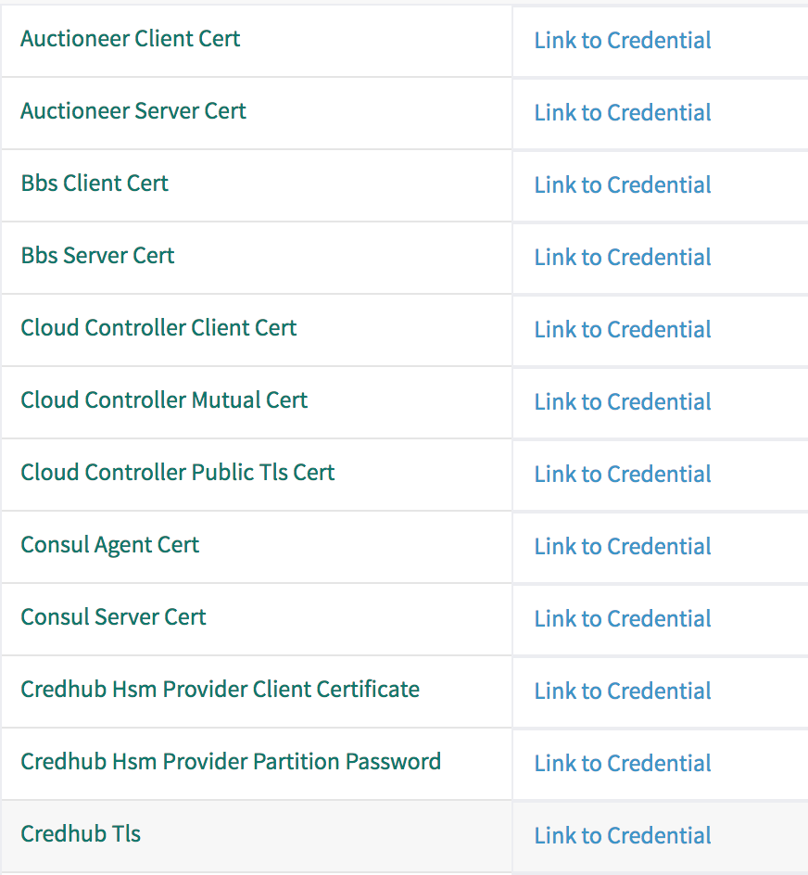
Operator Identity
Ops Manager UI
Ops Manager supports a single username and password for access to operations functions
Ops Manager creates randomized passwords for access to all managed VMs
VM credentials are visible in the Ops Manager UI
Bosh Director

Slide 25
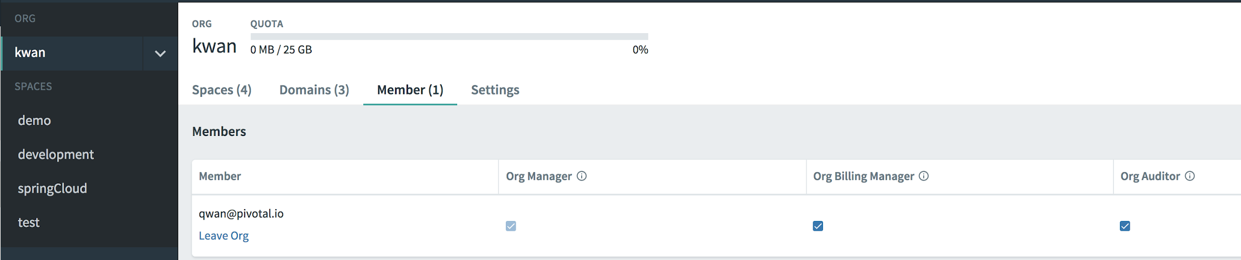
Organizations & Spaces
Organization
Top-most administrative unit
Typically a company, department, application suite or large project
Space
A logical way to organize users and resources (ex: staging and production)
Applications and services are scoped to a space

Slide 26
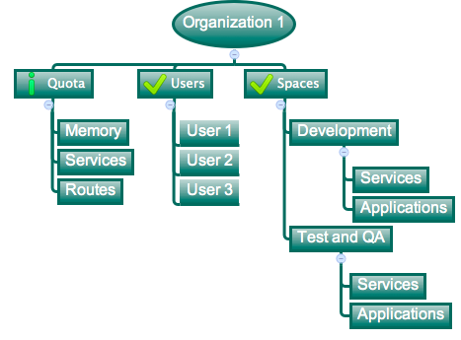
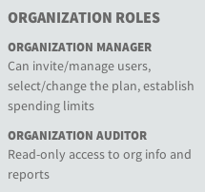
Organizations
Logical divisions for tenants, having their own Quotas and Users
User permissions are specified per Org and Space
User administration is delegated to the Org level

Slide 27

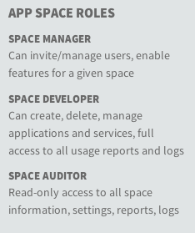
Spaces
Logical sub-division inside an Org
Users specified at the Org level can have different access levels per Space
Services and Applications are scoped to a Space

Slide 28
Network Security

Slide 29
Secure by default routing
Layers of routing security
Infrastructure & network security provided by IaaS
Client TLS termination options - LB, GoRouter, Both
Container IP not routable outside of the Diego Cell
Firewall blocks all east-west traffic
Sidecar envoy secures GoRouter to container ingress using TLS
Envoy certificate (app identity certificate) rotates every 24 hours

Slide 30
TLS Throughout
Diego Cell
Container
Iaas LB
GoRouter
Envoy
App

Slide 31
Isolation Segments
api.a.example.com
LB
GoRouter
Cloud Controller
BBS
Cells
Logging
Compute & Routing Isolation for Critical Workloads
LB
GoRouter
Cells
LB
GoRouter
Cells
Cells
Red
Isolation Segment
Blue
Isolation Segment
Green
Isolation Segment
Notes:
Isolation segments – isolate where workloads run with compute isolation, or isolate how traffic flows to your apps with routing isolation. https://content.pivotal.io/blog/tutorial-using-isolation-segments-in-pcf-for-hub-and-spoke-isolation

